Slide 1
Scene Labelling
Ashish Yadav, Rishabh Jain
Advisors: Kush Varshney, Prof. David Rosenberg

Slide 2
Goal
Labelling the individual components in a given scene
Able to identify the overall scene from the given Labels.
Analyze individual components in a scene.
Add a description to the image.

Slide 3
Methodology
Classification
Deciding whether an image contains a particular component or not
Support Vector Machines
Binary Class Classification
Multi Class Classification

Slide 4
Data Flow
Images
Pre Processing
Level 1 Labelling Binary Classifier: Linear SVM
Level 2 Labelling Multi Class Classifier : Multi Class SVM
Evaluation
Baseline algorithm Labeling

Slide 5
Labels
City
Road
Building
Snow
Tree
Beach
Sand
People
Sea
Sky
Rocks

Slide 6
Results
Label | Baseline Accuracy | SVM Accuracy
Building | 58 | 75
Ocean | 68 | 88
People | 61 | 80
Road | 54 | 66
Rock | 63 | 83
Sand | 67 | 85
Sky | 76 | 94
Snow | 69 | 80
Tree | 60 | 77

Slide 7
Level 2 Classifier Result
No results yet
Was planning to add some sample images and description, but I don’t understand what to write?

Slide 8
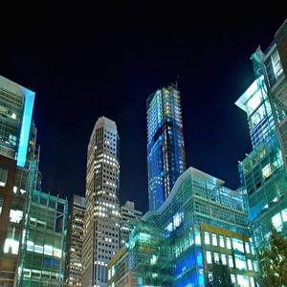
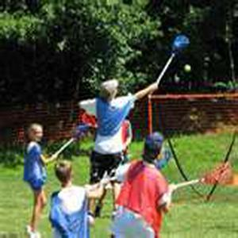
Sample Images
only building identified Night sky was difficult to guess
only people identified, could have done tree

Slide 9
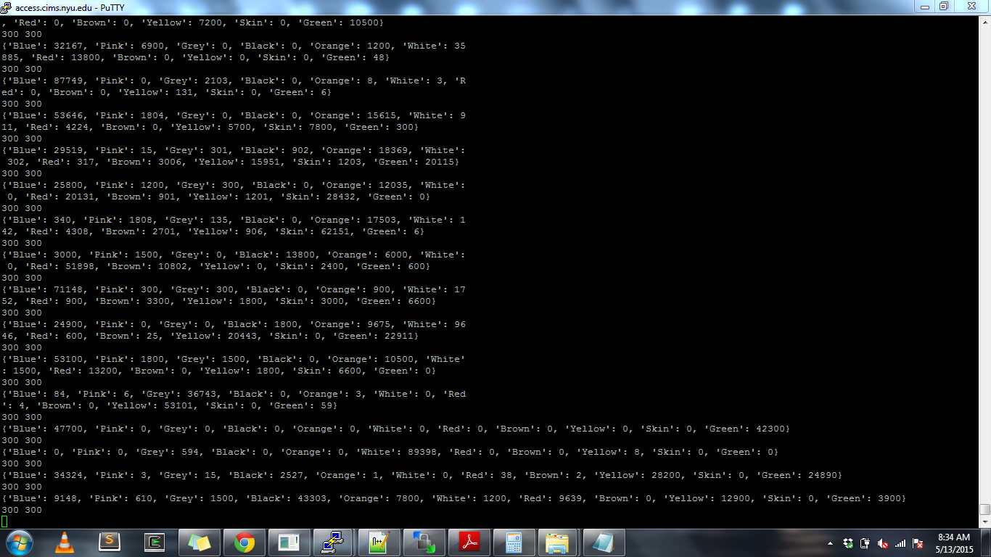
Baseline Algorithm
Do we add anything here? Or skip details on this?

Slide 10
References
Data Source : http://image-net.org/
Toolkit: Scikit-learn: Machine Learning in Python, Pedregosa et al., JMLR 12, pp. 2825-2830, 2011
Xiaofeng Ren, Liefeng Bo and Dieter Fox, RGB-(D) Scene Labeling: Features and Algorithms, CVPR 2012
Shuiwang Ji, Jieping Ye, Linear Dimensionality Reduction for Multi-label Classification, International Joint Conferences on Artificial Intelligence (IJCAI), 2009

